Slide 1


Slide 2
Self-initiated self-repair – edit terms (repair initiators)
English: I mean, well, or …
Spanish: digamos, bueno, o sea …
Mandarin: 就是說 …

Slide 3
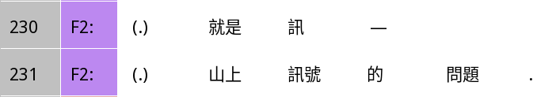
Self-initiated self-repair example
Trouble source: missed a word
Initiation
So it’s sig-
Completion
A problem with the signal on the mountain.
A | B | C | D | =C | E
就是 |  | 訊 |  |  | -
so it’s |  | sig
So it’s sig-
 | 山上 | 訊號 | 的 | 問題 | .
 | Mountaintop | signal | ‘s | problem
A problem with the signal on the mountain.

Slide 4
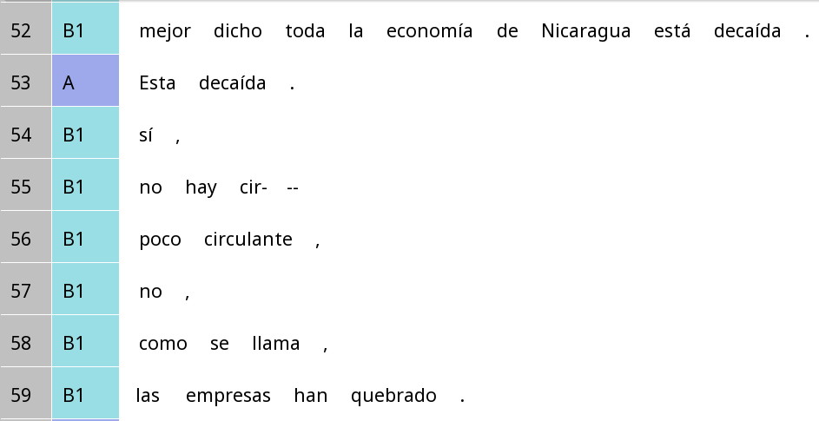
Self-initiated self-repair – Spanish
Better put the whole economy of Nicaragua is depressing
Is depressing.
Yes,
Trouble source
There is no wor-
Initiation (just cutting off)
Repair completion
Little working capital,
No,
What do you call it,
The companies have gone backrupt.

Slide 5
Self-initiated self-repair and resonance
Trouble source
Initiation (just cutting off)
Repair completion
A | B | C
no | hay | cir-
not | Is | wor-
There isn’t wor-
poco |  | circulante
little |  | Working capital
There is little signal.

Slide 6
Self-initiated self-repair (with little resonance) – Spanish
Better put the whole economy of Nicaragua is depressing
Is depressing.
Yes,
There is no wor-
Little working capital,
Trouble source
No,
Initiation (edit term)
What do you call it,
Repair completion
The companies have gone backrupt.

Slide 7
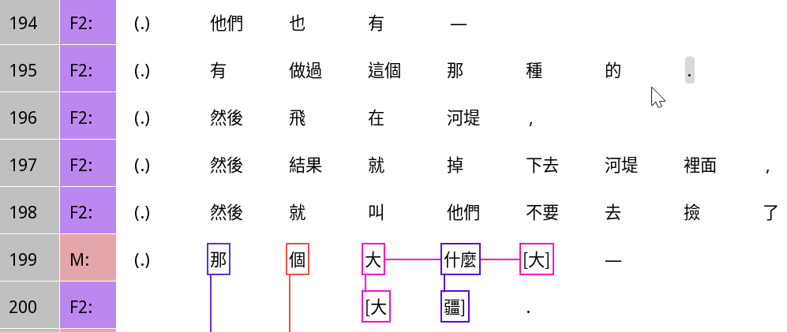
Self-initiated other-repair example
They have also -
They have done that kind,
They fly by the river bluffs,
Then it fell into the river bluffs.
Then they tell them not to pick it up.
Trouble source: after 大 dà
That dà what dà -
Initiation: 什麼 shénme ‘what’
Dà jiāng.
Completion

Slide 8
Self-initiated other-repair example
Frame resonance
Focal resonance
A | B | C | D | =C | E
那 | 個 | 大 | 什麼 | 大 | -
that | CLF | dà | what | dà
That dà what dà -
 |  | 大 | 疆 |  | .
 |  | dà | jiāng
Dà jiāng.

Slide 9
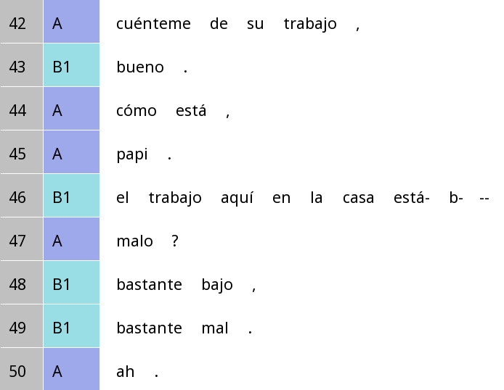
Self-initiated + other-initiated repair example in Spanish
Trouble source
Other-initiation
Self-initiation: Cutting off after está, b
Repair completion

Slide 10
Other-initiated repair: Common open request expressions
Open class
 | Interjection | Question word | Other
English | Hunh? | What? | Pardon?
Spanish | ¿Eh? | ¿Qué? | ¿Mande?
Mandarin | 哈？啊？ | 啥？

Slide 11
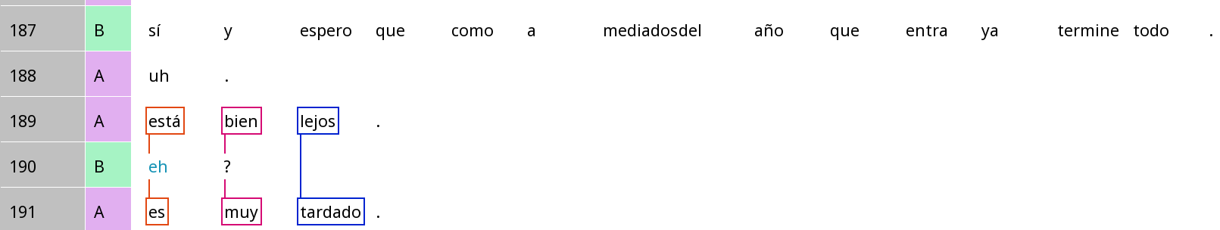
Other-initiated repair in Spanish with ¿eh?
Yes and I hope that everything will be over by the middle of the year.
Trouble source
That’s pretty far.
Other-initiation
It’s really late.
Repair completion

Slide 12
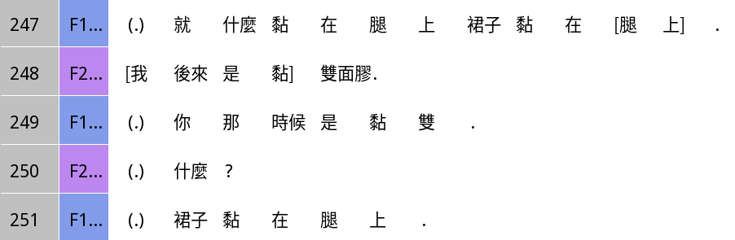
Other-initiated repair in Mandarin: Open request
So like stuck it to the legs, stuck the skirt to the legs
I later stuck it with double-sided tape.
You stuck it with double at the time.
What?
Stuck the skirt to the legs.

Slide 13
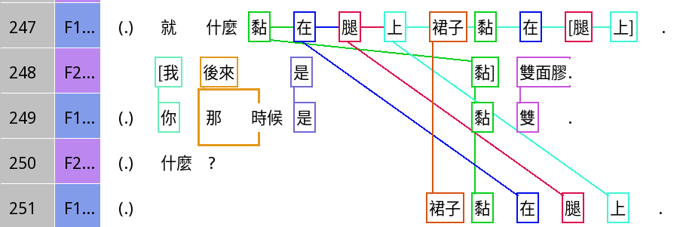
Other-initiated repair in Mandarin: Open request
So like stuck it to the legs, stuck the skirt to the legs
I later stuck it with double-sided tape.
You stuck it with double at the time.
What?
Stuck the skirt to the legs.

Slide 14
Other-initiated repair in Mandarin: Open request
A | B | C | D | =C | E
裙子 | 黏 | 在 | 腿 | 上 | .
dress | stuck | at | leg | on | .
Stuck the skirt to the legs.
甚麼 |  |  |  |  | ?
What? |  |  |  |  | ?
What?
裙子 | 黏 | 在 | 腿 | 上 | .
dress | stuck | at | leg | on | .
Stuck the skirt to the legs.

Slide 15
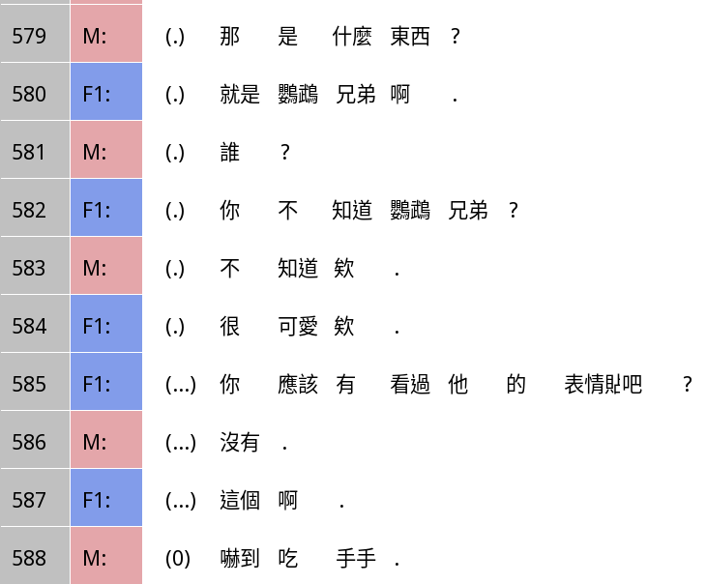
Other-initiated repair in Mandarin: Restricted request – question word
Trouble source
What’s that?
It’s the parrot brothers.
Initiation
Who?
(Insert sequence …)
You don’t know the parrot brothers?
I don’t know them.
They’re cute!
You should have seen their stickers right?
Nope.
Repair completion
It’s this one.
I’m so scared I’m eating my hand.

Slide 16
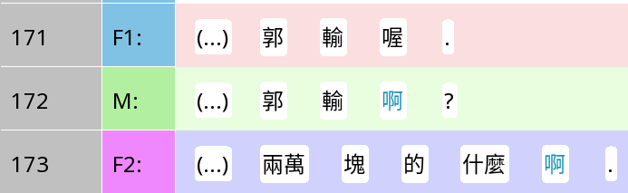
Other-initiated repair in Mandarin: Restricted offer - a-suffixed repetition
Trouble source
Kuo lost you know.
Initiation
Kuo lost a?
(No actual completion, but an elaboration to affirm it)
NT$20k or what have you.

Slide 17
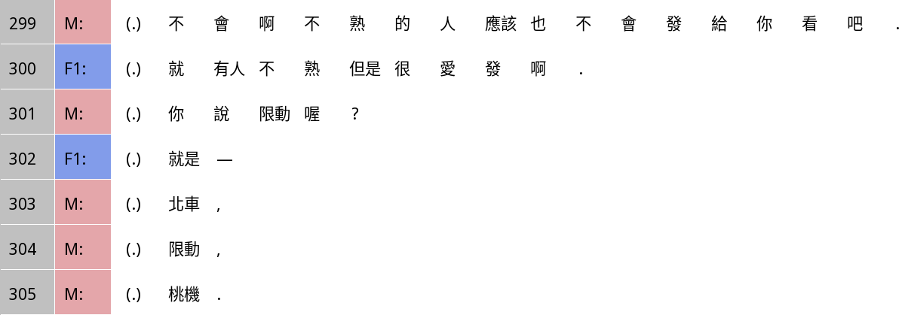
Other-initiated repair in Mandarin: Restricted offer – 你說 nǐ shuō ‘you’re saying’ …
Trouble source: ‘send’ has no object, creating ambiguity
Nah, people you don’t know well wouldn’t send you (things).
But there are people who you don’t know well but love sending (things).
Initiation
You mean Instagram stories?
(Repair not completed, M interrupted)

Slide 18
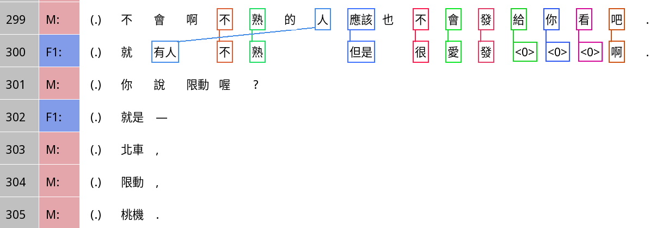
Other-initiated repair in Mandarin: Restricted offer – 你說 nǐ shuō ‘you’re saying’ …

Slide 20
More repair grammar: Japanese tte and kke

